Slide 1
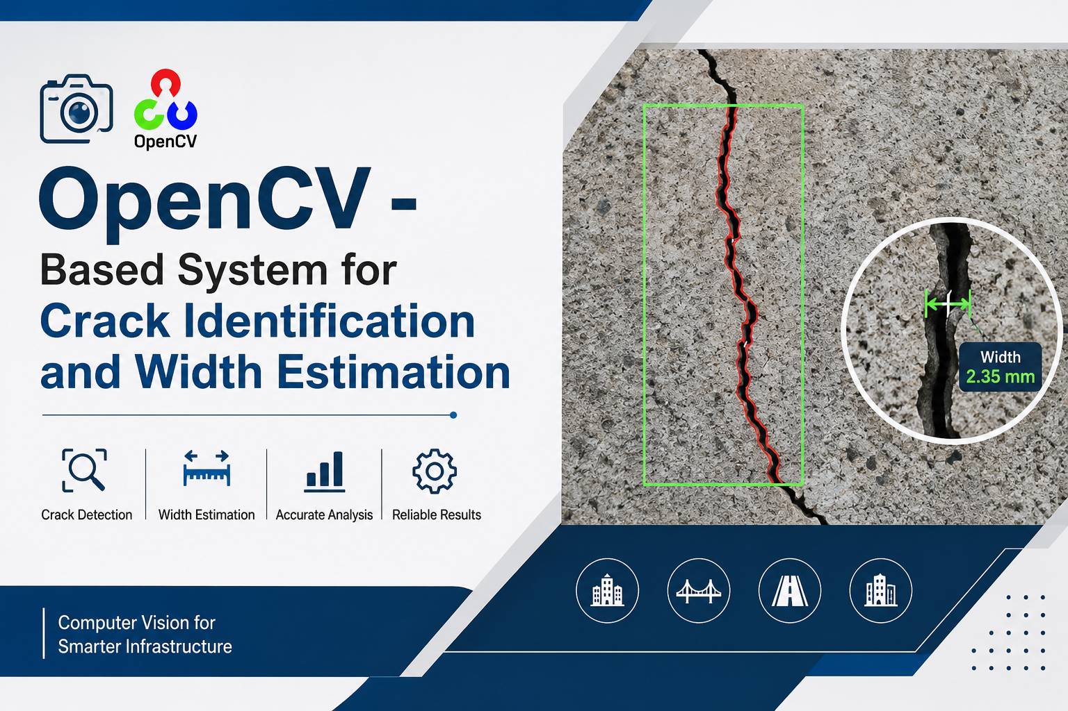

Slide 2
1. Technology Stack

Slide 3
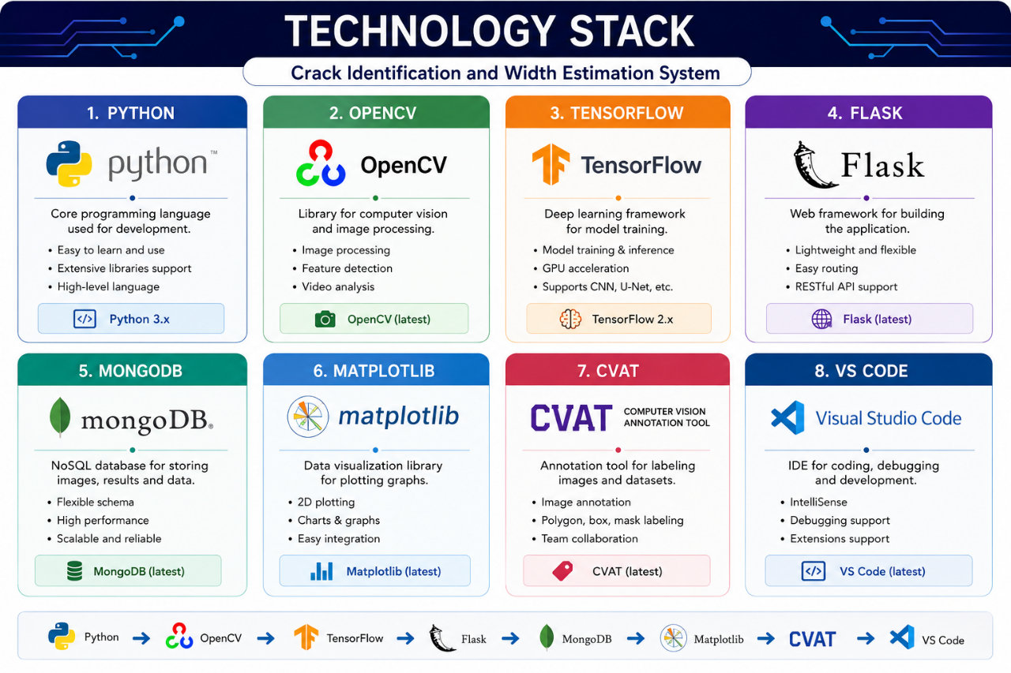

Slide 4
2. Project Architecture

Slide 5
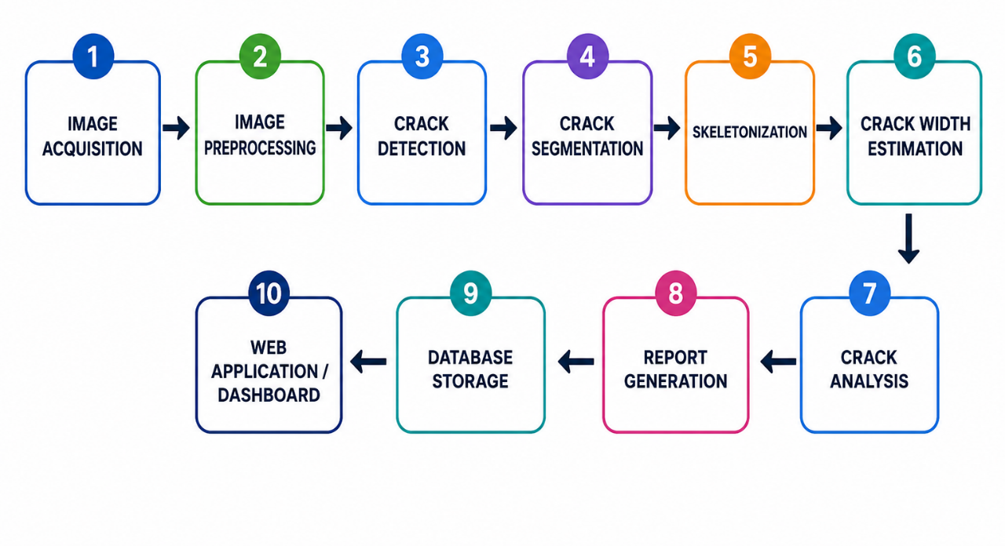

Slide 6
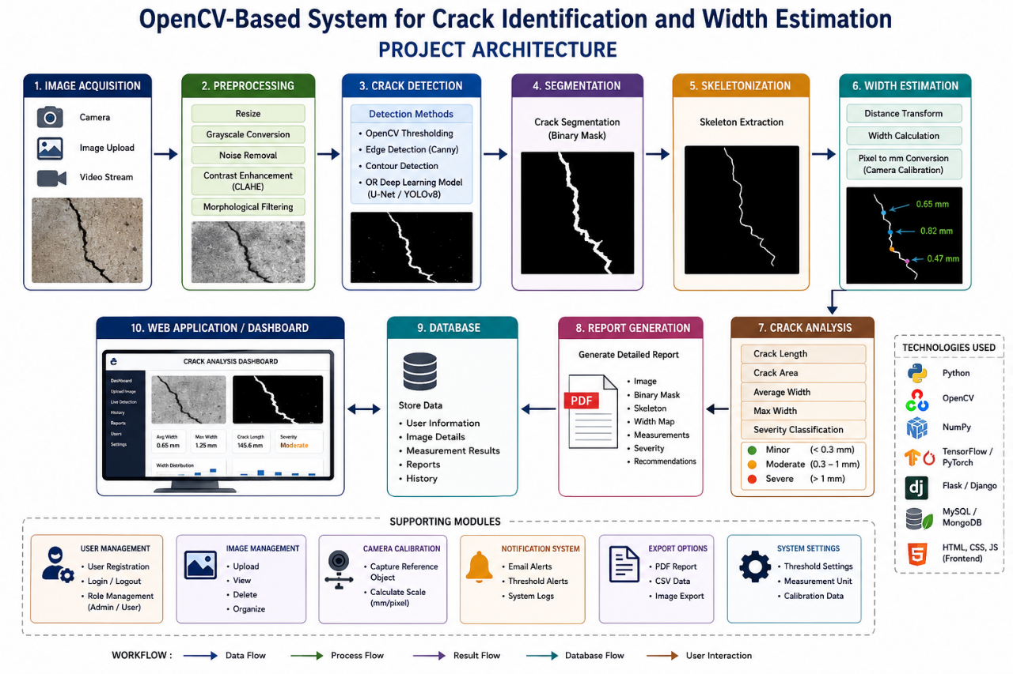

Slide 7
3. Complete Workflow

Slide 8
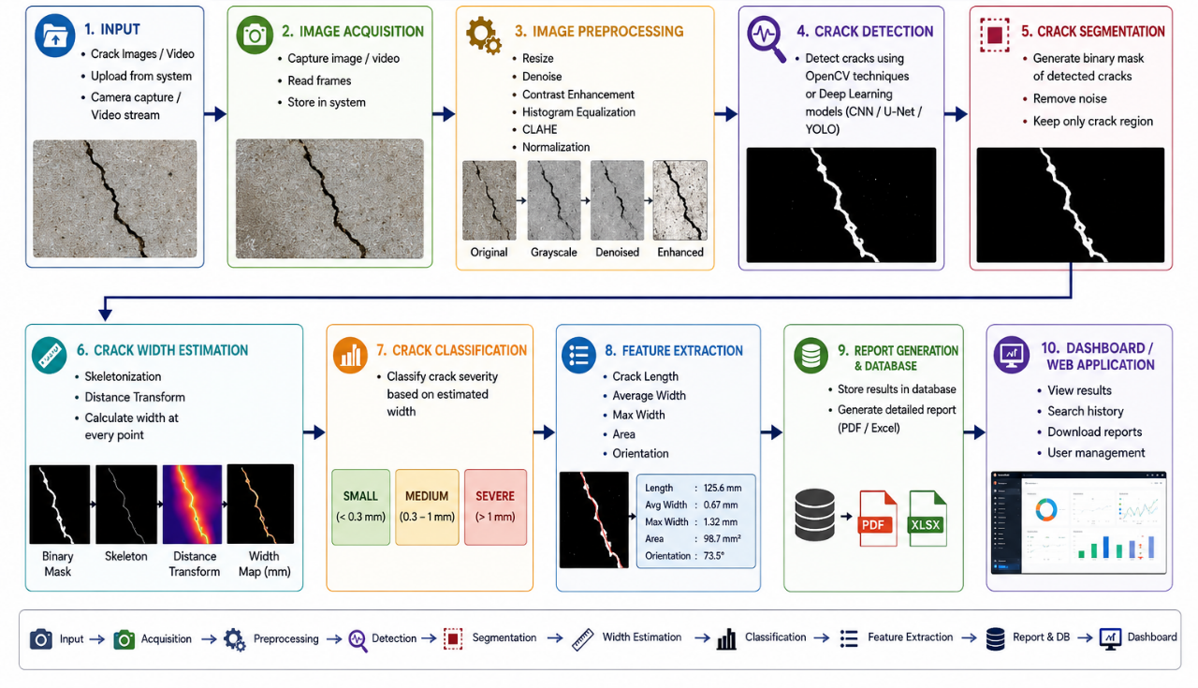

Slide 9
4. Open-CV Processing Pipeline

Slide 10
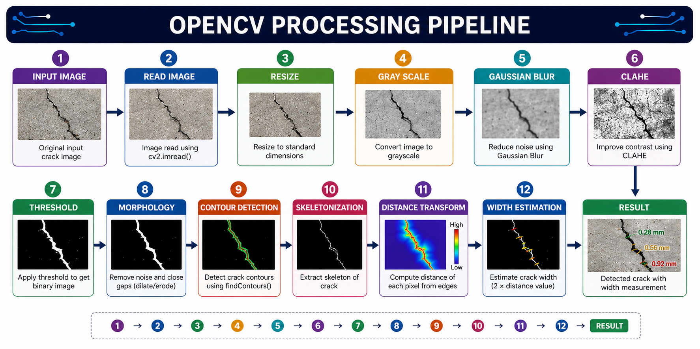

Slide 11
5. CRACK WIDTH ESTIMATION METHOD

Slide 12
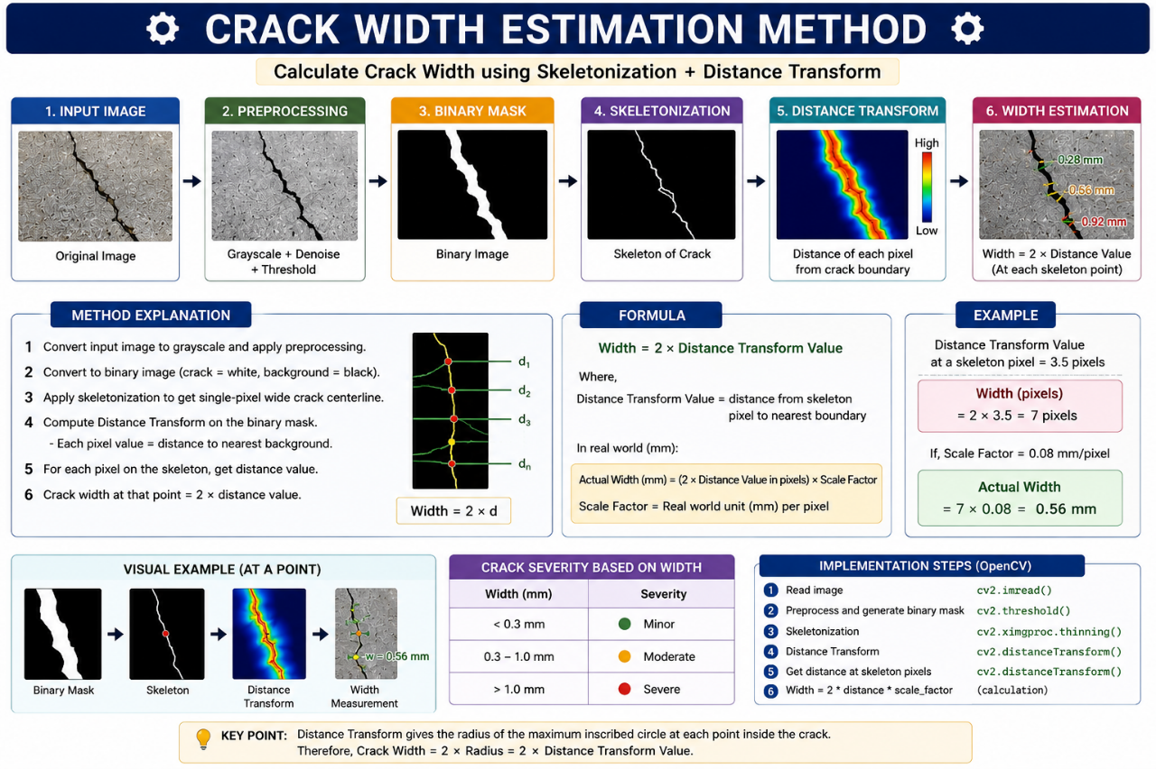

Slide 13
6. Crack Severity

Slide 14
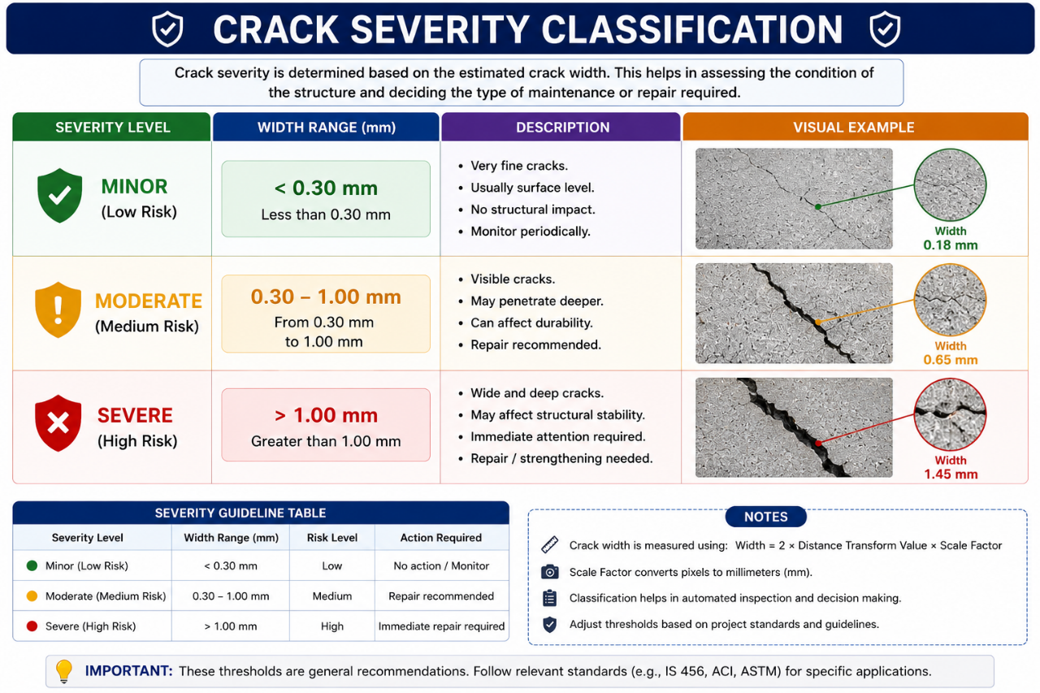

Slide 15
7. Features

Slide 16
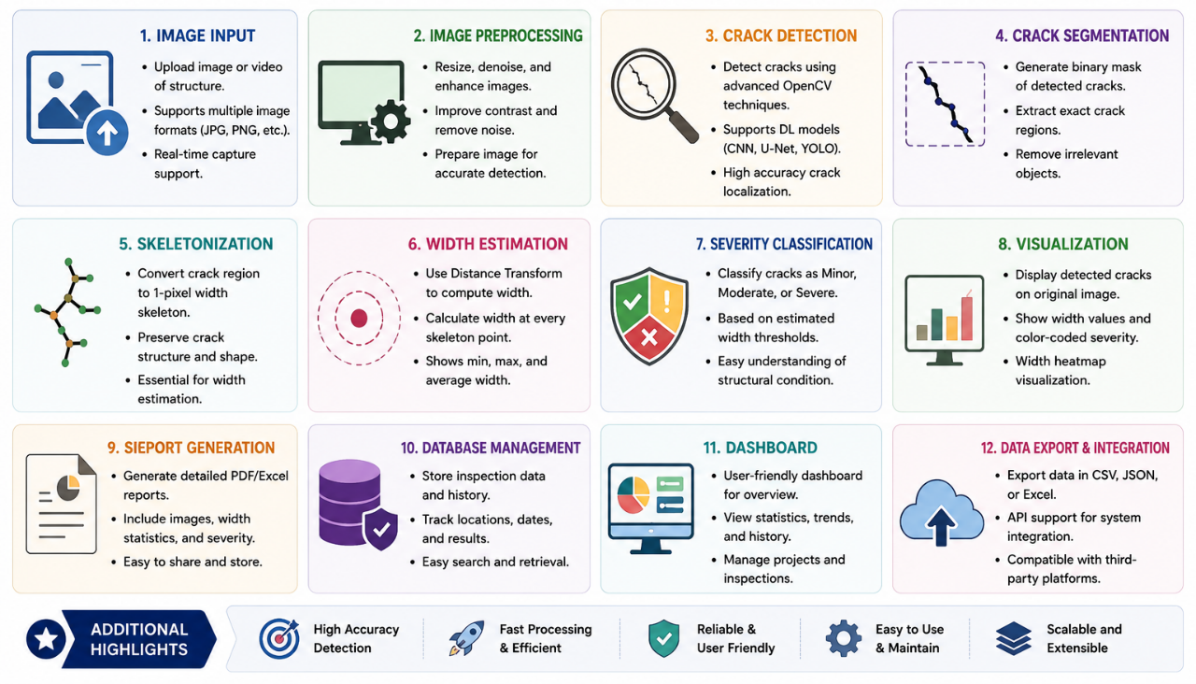

Slide 17
8. Expected Output

Slide 18
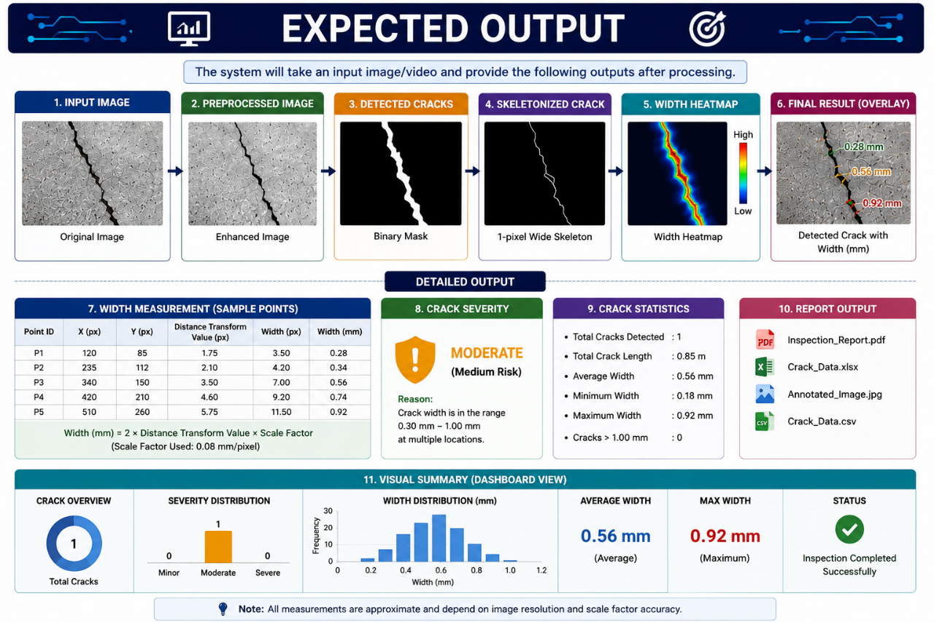

Slide 19


